Slide 1





TITLE:-
UNVEILING THE CODE OF LIFE - A PEDIGREE MODEL

Slide 2

TEAM MEMBERS
SHASHMITA SANYAL
REG. NO.:- 22BHI10034
SHREYA RAJ GUPTA
REG. NO. :- 22BHI10143
JIGISHA DHARSKAR
REG. NO.:- 22BHI10050
ISHA CHOUDHARY
REG. NO. :- 22BHI10124

Slide 3


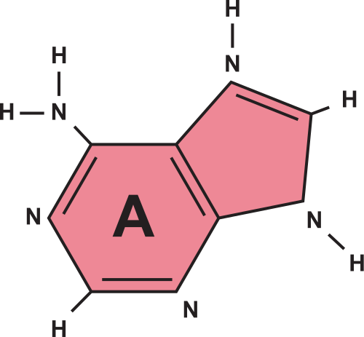
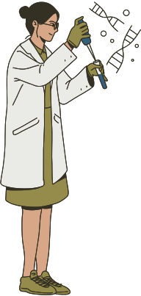
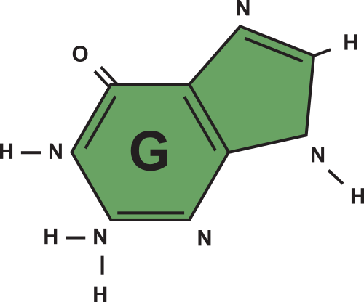
GUIDE
Introduction
Objective statement
Literature Review
Proposed work
Modules & Explanation
Real time usage
Hardware & software requirements
Overall system architecture diagram
Project timeline chart
References
Conclusion

Slide 4

UNVEILING THE CODE OF LIFE
Introduction
Early Studies, Abstract, Framework

Slide 5

Early Studies
GENETIC RISK PREDICTION
Despite the identification of thousands of disease-associated genetic variants through GWAS, genetic risk prediction accuracy remains moderate for most diseases. WHY???

Slide 6


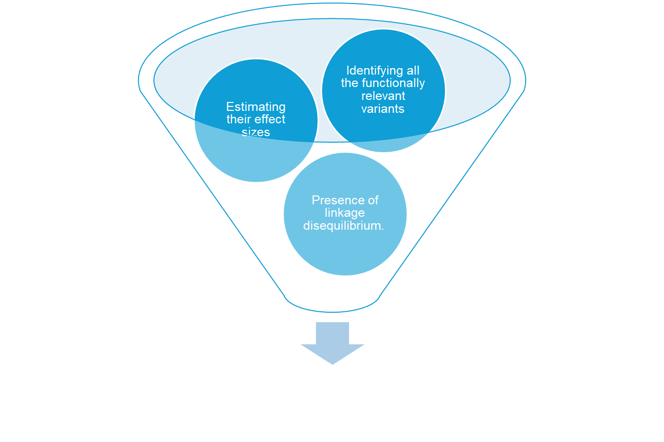
What are we
tackling here?

Slide 7

Unveiling the code of life
GENETIC RISK PREDICTION
A principled framework that leverages diverse types of genomic and epigenomic functional annotations in genetic risk prediction for complex diseases.

Slide 8

UNVEILING THE CODE OF LIFE
Objective
What diseases we hope to predict susceptibility

Slide 9

Objective
The objective of this study is to develop and evaluate a novel genetic risk prediction framework, which integrates various types of genomic annotations with genome-wide association study (GWAS) summary statistics to improve the accuracy of disease risk prediction, in both extensive simulations and real data, in comparison with state-of-the-art risk prediction methods.

Slide 10

Target Diseases
WHY OUR MODEL NEEDS TO BE MADE
IBD Disease
Type-II Diabetes
Reduced number of diseases to focus on higher accuracy and efficiency of each model

Slide 11
Celiac disease is an autoimmune disorder triggered by the ingestion of gluten, causing damage to the small intestine and impairing nutrient absorption.
Type 2 diabetes is a metabolic disorder characterized by high blood sugar levels resulting from insulin resistance and inadequate insulin production by the pancreas.

Slide 12

Shortcomings of earlier models
WHY OUR MODEL NEEDS TO BE MADE

Slide 13
Limitations of Earlier Models
Previous models frequently disregarded functional details regarding the genetic variations Ignorance of functional data may lead to missed biologically significant insights and decreased disease risk prediction accuracy.
Many earlier models did not consider interactions between different genetic variants or genes.
Some models were developed using data from specific populations, which limited their generalizability to other populations.

Slide 14
But there are also significant obstacles to genetic risk prediction models, such as extremely high dimensionality, restricted access, and effective computational techniques for genotype data at the individual level.
By integrating genomic functional annotations, which have been successfully used in GWAS to generate biological insights, we propose a novel approach to address these issues and make use of rich GWAS summary statistics.

Slide 15

Challenges
UPHILL CLIMB
A challenge is intelligence at a tease

Slide 16
CHALLENGES
Obtaining comprehensive and accurate functional annotation data across diverse populations can be challenging due to limitations in data collection, experimental techniques, and variability in annotation sources.
Given the variety of genomic and epigenomic functional annotations that can be integrated, data integration techniques must be carefully considered.

Slide 17
Model complexity and computational resource requirements may rise when various functional annotation types are included and linkage disequilibrium is modeled in a Bayesian framework.
As models become more complex with the incorporation of multiple types of functional annotations, maintaining interpretability and transparency becomes challenging.

Slide 18

UNVEILING THE CODE OF LIFE
Literature Review
Datasets, GWAS, PRS, Methods

Slide 19

Datasets
TRAINING AND TESTING SOURCES
We shall train our model using publicly accessible GWAS summary statistics and evaluated risk prediction performance using individual-level genotype and phenotype data from cohorts independent from the training samples.

Slide 20
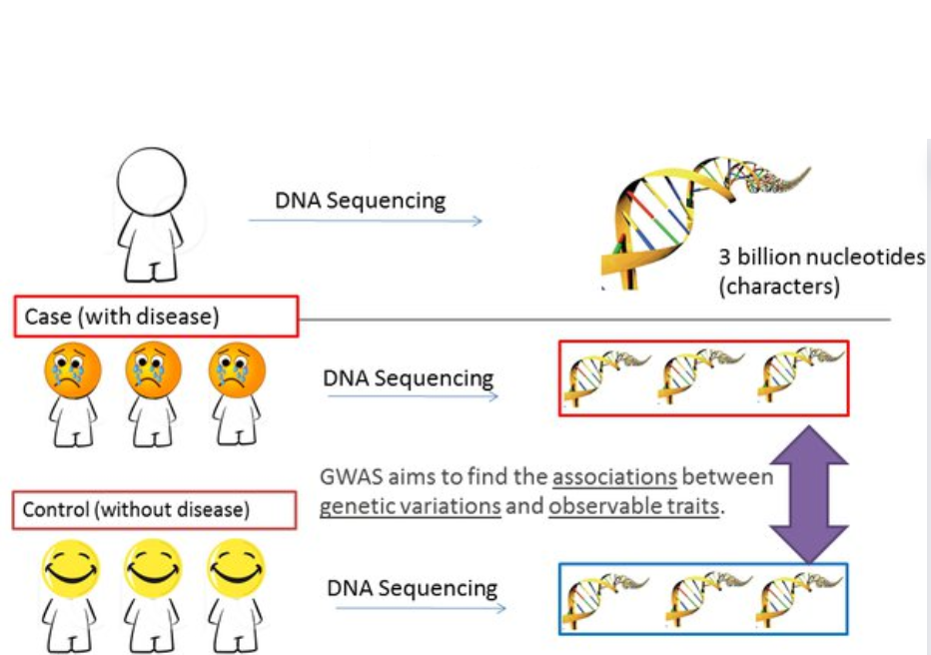
What is GWAS?
GENOME-WIDE ASSOCIATION STUDIES

Slide 21
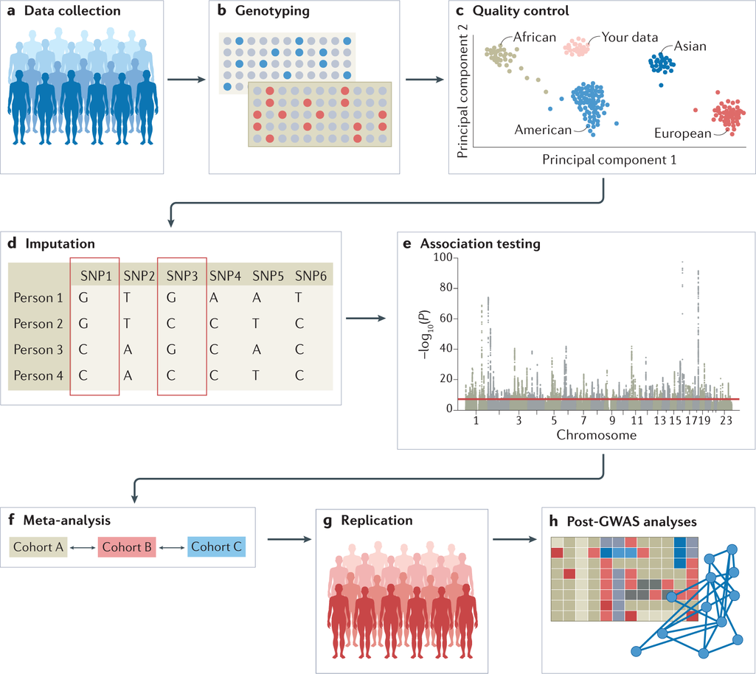
GWAS
MEANING & WORKFLOW
Genome-wide association studies (GWAS) help scientists identify genes associated with a particular disease. This method studies the entire genome of a large group of people, searching for small variations, called single nucleotide polymorphisms or SNPs. Each study can look at hundreds or thousands of SNPs at the same time. Scientists can then identify SNPs that occur more frequently in people with a certain disease than in people without it. These SNPs are said to be associated with the disease, and they can help researchers pinpoint genes that are likely involved in disease development.

Slide 22
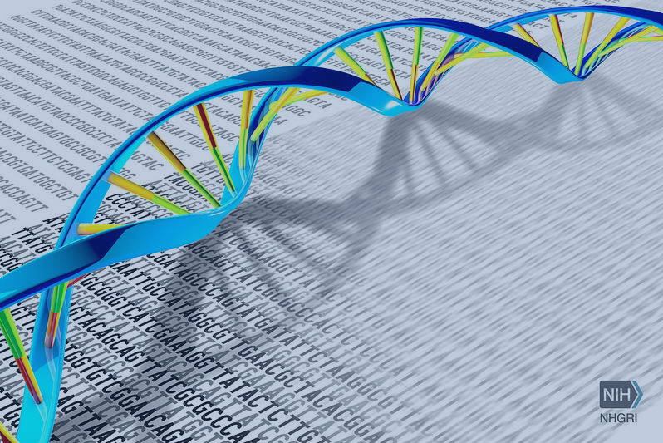
RISK PREDICTION FRAMEWORK
Methods
We estimate GWAS signal,
Propose an empirical prior of SNP effect size
Which is adopted in a Bayesian framework

Slide 23

WORKFLOW
For IBD Disease

Slide 24

WORKFLOW
For Type - II Diabetes

Slide 25

Proposed Work
Mechanisms, Algorithms, Examples, & Novelties

Slide 26

Genome Function Prediction
AND ITS MECHANISM
Functional genome prediction is the process of predicting how variations in the DNA can impact the functioning of the genes that ultimately results in the risk of developing some diseases.

Slide 27
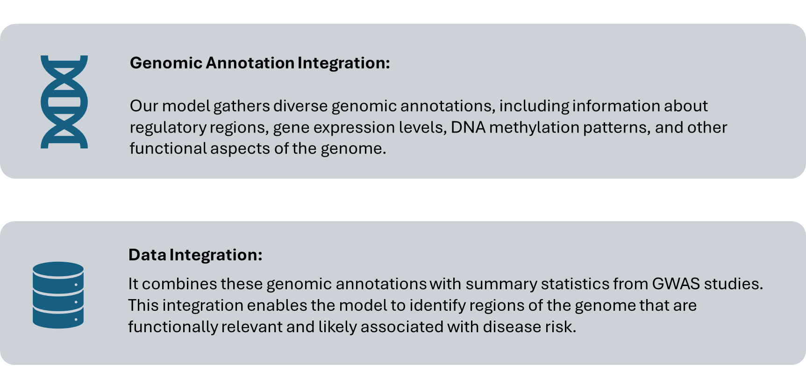
Typical Mechanisms

Slide 28
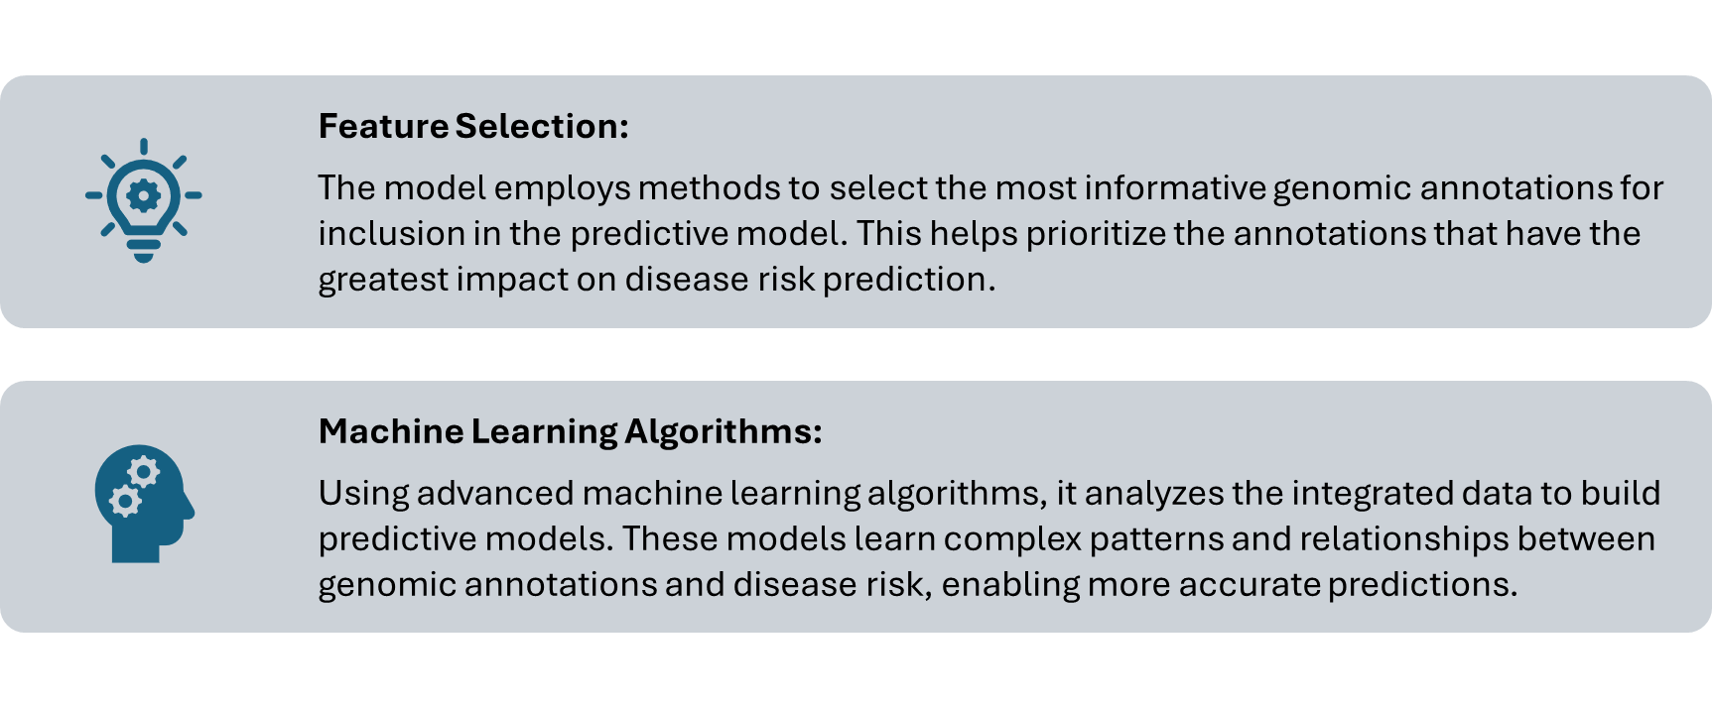
Typical Mechanisms

Slide 29
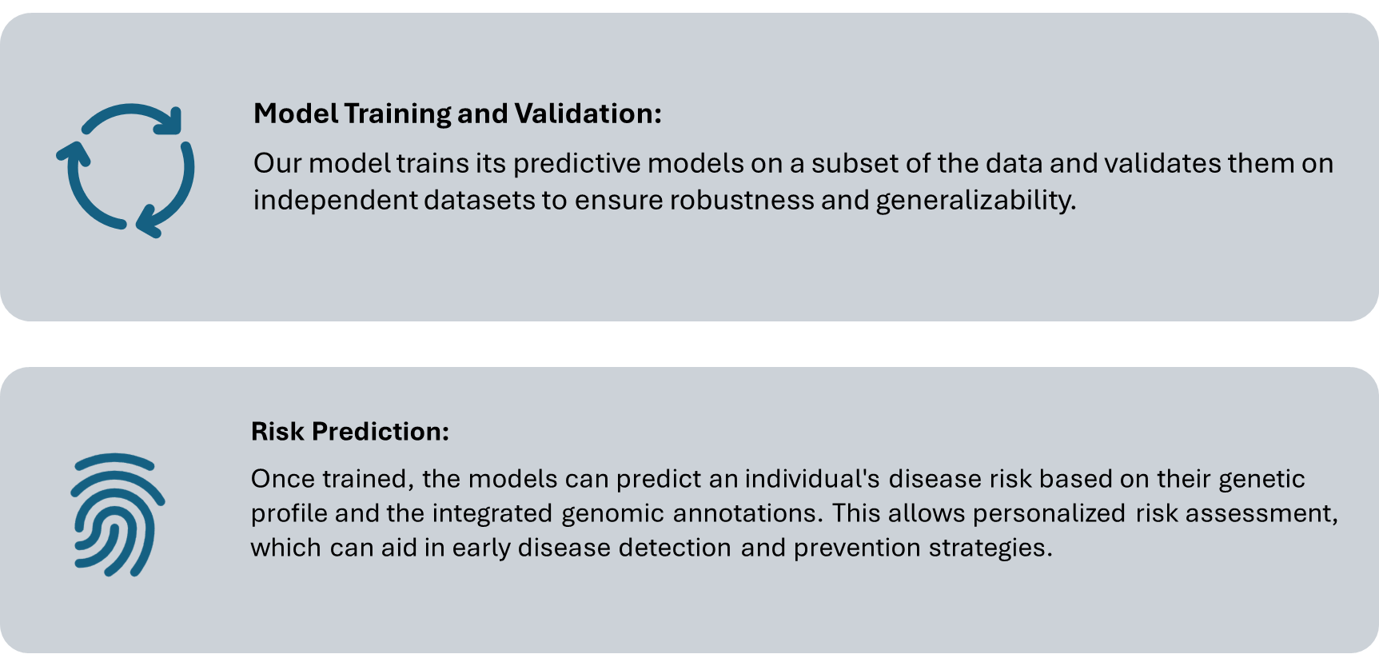
Typical Mechanisms

Slide 30

eg:Type 2 Diabetes risk Prediction:-
Our model also improves the accuracy of predicting the risk of Type-2 Diabetes. Now, this integrates the genomic annotations with the GWAS statistics which is related to Type-2 Diabetes. By applying these annotations into the prediction model, this will improve the accuracy, as compared to conventional methods.

Slide 31

Novelties of our model
NECESSITY IS THE MOTHER OF INNOVATION
Genomic Annotations,
Weighting scheme,
PRS Construction,
Bayesian Framework
and more

Slide 32
(i) Integration of Genomic Annotations: The model include diverse genomic annotations, including functional annotations, regulatory elements, chromatin accessibility, and other relevant genomic features. These annotations provide additional context and biological insights into the genetic variants associated with a particular disease.
(ii) Polygenic Risk Score (PRS) Construction: The model constructs polygenic risk scores (PRS) based on the integrated genomic annotations and GWAS summary statistics. PRS is a weighted sum of risk alleles across multiple genetic variants, and our model also optimizes the weighting scheme to maximize predictive accuracy.

Slide 33

HARDWARE AND SOFTWARE REQUIREMENTS
SOFTWARES
Computer or Server
Storage: Adequate storage space is essential for storing datasets, model files, and intermediate results. Depending on the size of our data, we may need terabytes of storage space.
GPU (Graphics Processing Unit)
. We will need Python 2.7 and several pacakges to run it:
h5py
plinkio
scipy
numpy
sklearn
pandas == 0.18.1 (required for munge step in LDSC),etc
HARDWARES

Slide 34

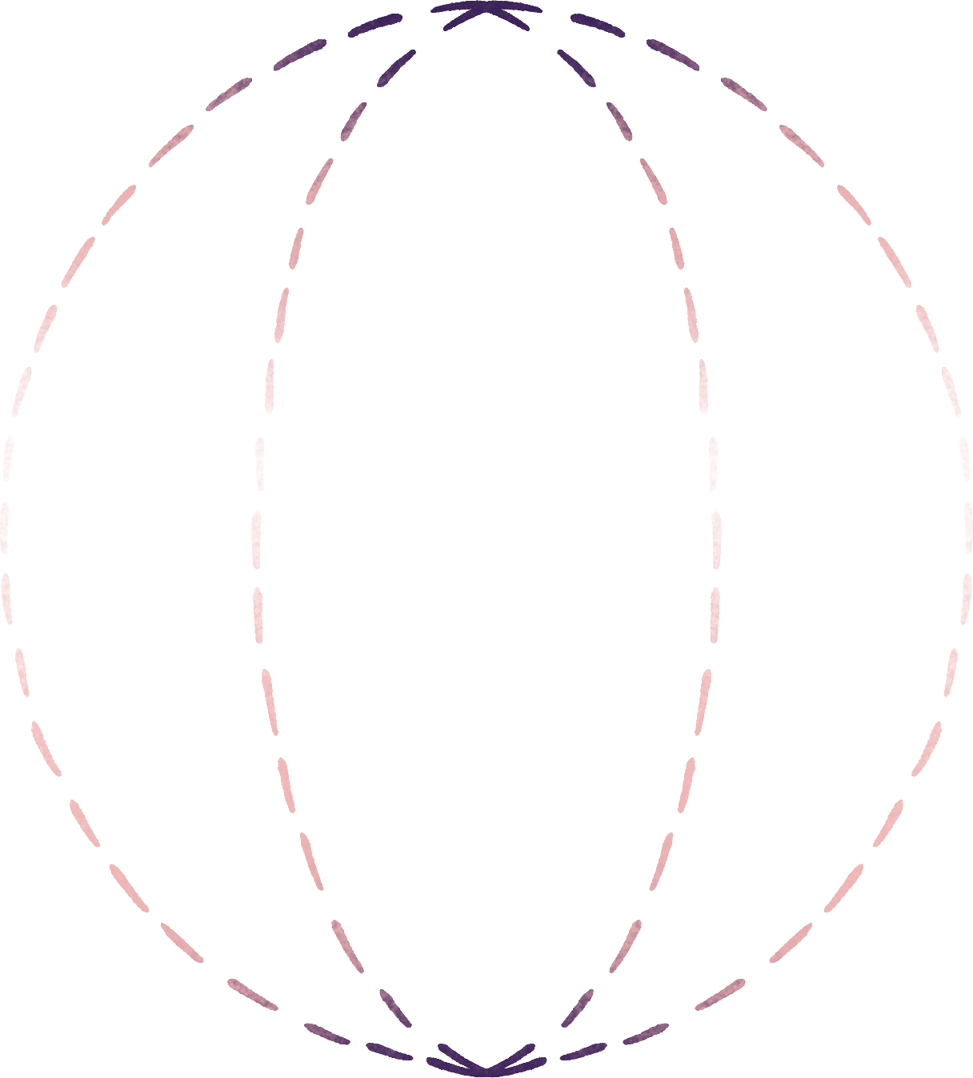

REAL TIME USAGE
The real-time usage of our models involves preparing data, training the model, validating it, integrating it into an application, deploying it for real-time prediction, and continuously monitoring and improving its performance based on feedback and iteration.
Data Preprocessing: Prepare the genomic and epigenomic functional annotations as well as the GWAS summary statistics. This may involve data cleaning, normalization, and formatting to ensure compatibility with the AnnoPred framework.
Training the Model: Utilize the AnnoPred framework to train the model using the prepared data. This involves specifying the Bayesian framework, explicitly modeling various functional annotations, and incorporating linkage disequilibrium estimated from reference genotype data.
Validation: Validate the trained AnnoPred model using appropriate validation techniques. This may involve cross-validation or splitting the dataset into training and testing sets.

Slide 35
REAL TIME USAGE
Prediction: Once the model is trained and validated, it can be used for real-time risk prediction for complex diseases. This involves applying the trained model to new GWAS summary statistics data to predict the genetic risk for individuals.
Integration into Application: Integrate the AnnoPred model into an application or system where real-time risk prediction is required. This may involve developing a user interface for inputting GWAS summary statistics data and displaying the predicted risk scores.
Deployment and Monitoring: Deploy the application incorporating AnnoPred for real-time risk prediction. Continuously monitor the performance of the model and update it as needed with new data or improvements to the framework.

Slide 36

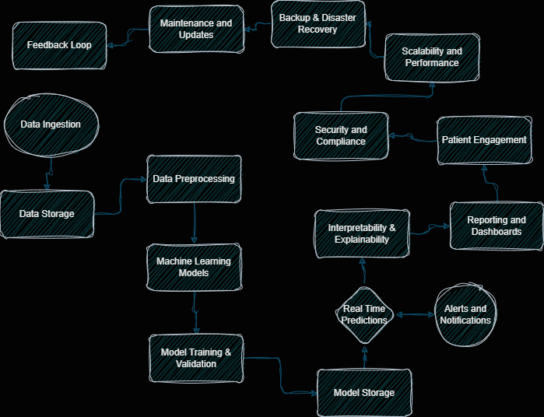

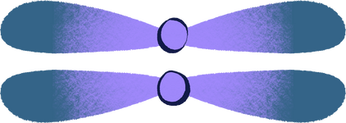

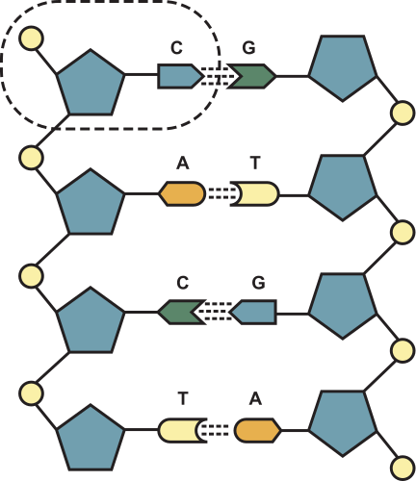

Overall System Architecture Diagram

Slide 37
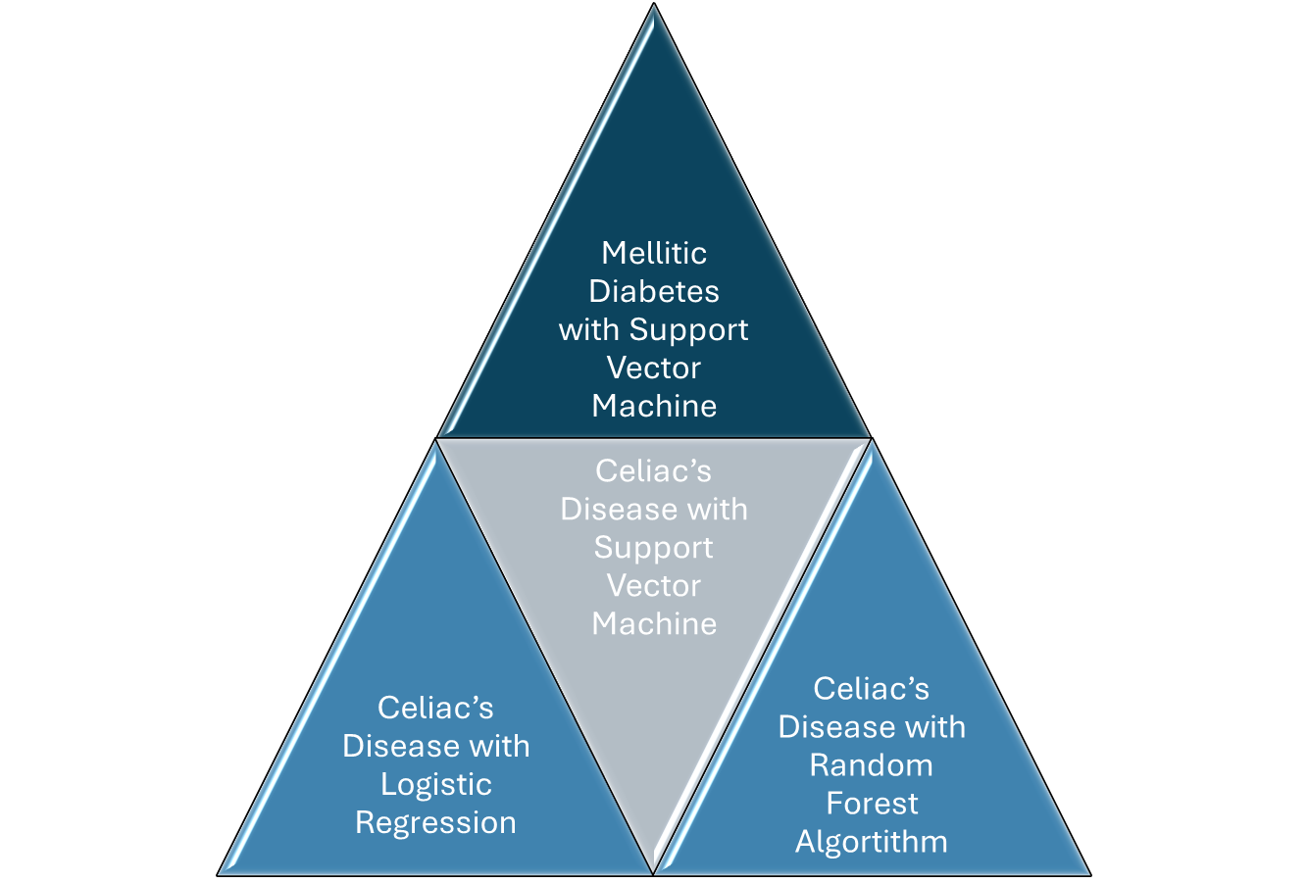
MODULES
and their
Distribution
n

Slide 38
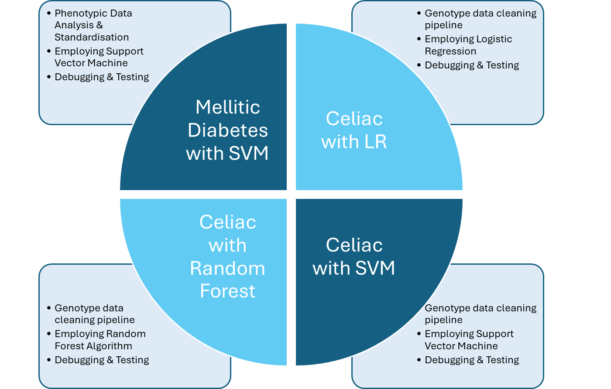
MODULES WORK
FLOW
n

Slide 39
PROJECT TIMELINE CHART
Phase-1 Of Project Exhibition
 | Start Date | End Date
Team Formation | 20/02/2024 | 28/02/2024
Data Collection | 03/03/2024 | 5/03/2024
Literature Review | 6/03/2024 | 9/03/2024

Slide 40
REFERENCES
1. N. Chatterjee, J. Shi, and M. Garcia-Closas, "Developing and evaluating polygenic risk prediction models for stratified disease prevention," *Nature Reviews Genetics*, advance online publication, 2016, doi: 10.1038/nrg.2016.27. PMID: 27140283.
2. M. I. McCarthy et al., "Genome-wide association studies for complex traits: consensus, uncertainty and challenges," *Nature Reviews Genetics*, vol. 9, no. 5, pp. 356-369, 2008. doi: 10.1038/nrg2344. PMID: 18398418.
3. Z. Wei et al., "Large sample size, wide variant spectrum, and advanced machine-learning technique boost risk prediction for inflammatory bowel disease," *The American Journal of Human Genetics*, vol. 92, no. 6, pp. 1008-1012, 2013. doi: 10.1016/j.ajhg.2013.04.014. PMID: 23731541.
4. D. J. Cutler et al., "Dissecting Allele Architecture of Early Onset IBD Using High-Density Genotyping," *PLOS ONE*, vol. 10, no. 6, p. e0128074, 2015. [Online]. Available: https://dataverse.unc.edu/api/access/datafile/7183963. doi: 10.1371/journal.pone.0128074.

Slide 41
X. Zhou, P. Carbonetto, and M. Stephens, "Polygenic modeling with Bayesian sparse linear mixed models," PLoS Genetics, vol. 9, no. 2, p. e1003264, 2013. doi: 10.1371/journal.pgen.1003264. PMID: 23408905.
D. Speed and D. J. Balding, "MultiBLUP: improved SNP-based prediction for complex traits," Genome Research, vol. 24, no. 9, pp. 1550-1557, 2014. doi: 10.1101/gr.169375.113. PMID: 24963154.
J. Minnier, M. Yuan, J. S. Liu, and T. Cai, "Risk classification with an adaptive naive bayes kernel machine model," Journal of the American Statistical Association, vol. 110, no. 509, pp. 393-404, 2015. doi: 10.1080/01621459.2014.904726. PMID: 26236061.

